Slide 1
Olympia dictionary
Sergii Opryshko 7759145 sopryshko9145@conestogac.on.ca
Brahmpreet Singh 7845159 brahmpreet.official@gmail.com
Sharfaraz Ahamed Bachinvalapan Hameed 7834120 sharfrazq17@gmail.com
Anju Mathew 7804396 10mathew10@gmail.com

Slide 2
Problem statement
1 billion - learning English worldwide
750 million - English as a Foreign Language speakers (British Council 2000)
375 million - English as second language speakers
Increased to 1.5 billion (2014)
No single app that allows the users to manipulate the words they search for
Solution: smartphone application that uses public APIs of popular dictionaries and allows the users to manipulate the words they search for

Slide 3
Mission and Vision
Mission – To give people the possibility to learn English language faster and more efficiently and connect people with same aspirations
Vision – Learning foreign language easy with the help of modern ethnologies

Slide 4
Key Features
Put words in categories
Self checking tests (quizzes) and statistics
Multiple languages support
Personalized and customizable
Accessibility features - OCR, TTS, STT, font size
Social network support

Slide 5
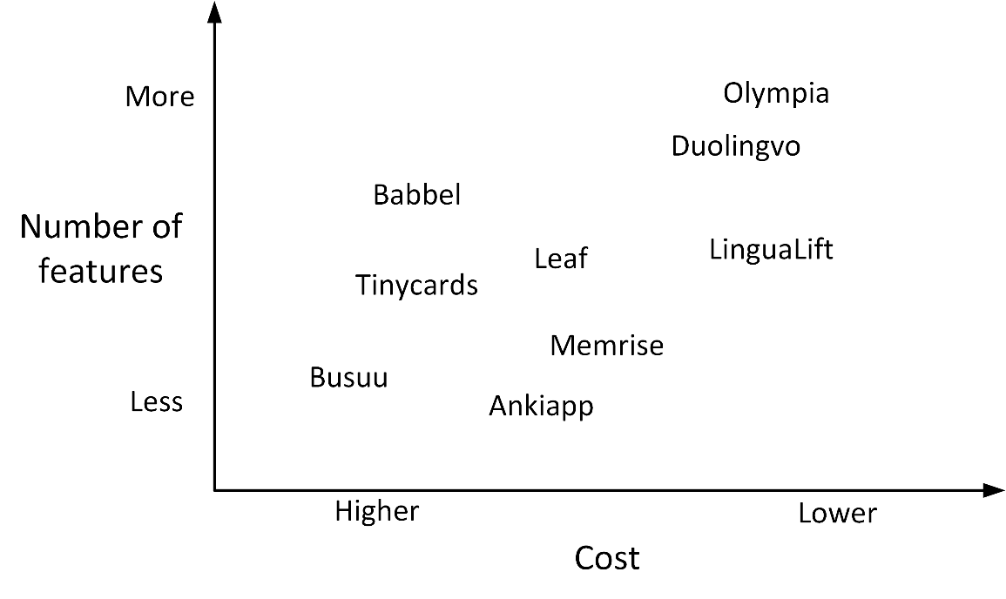
Competition

Slide 6
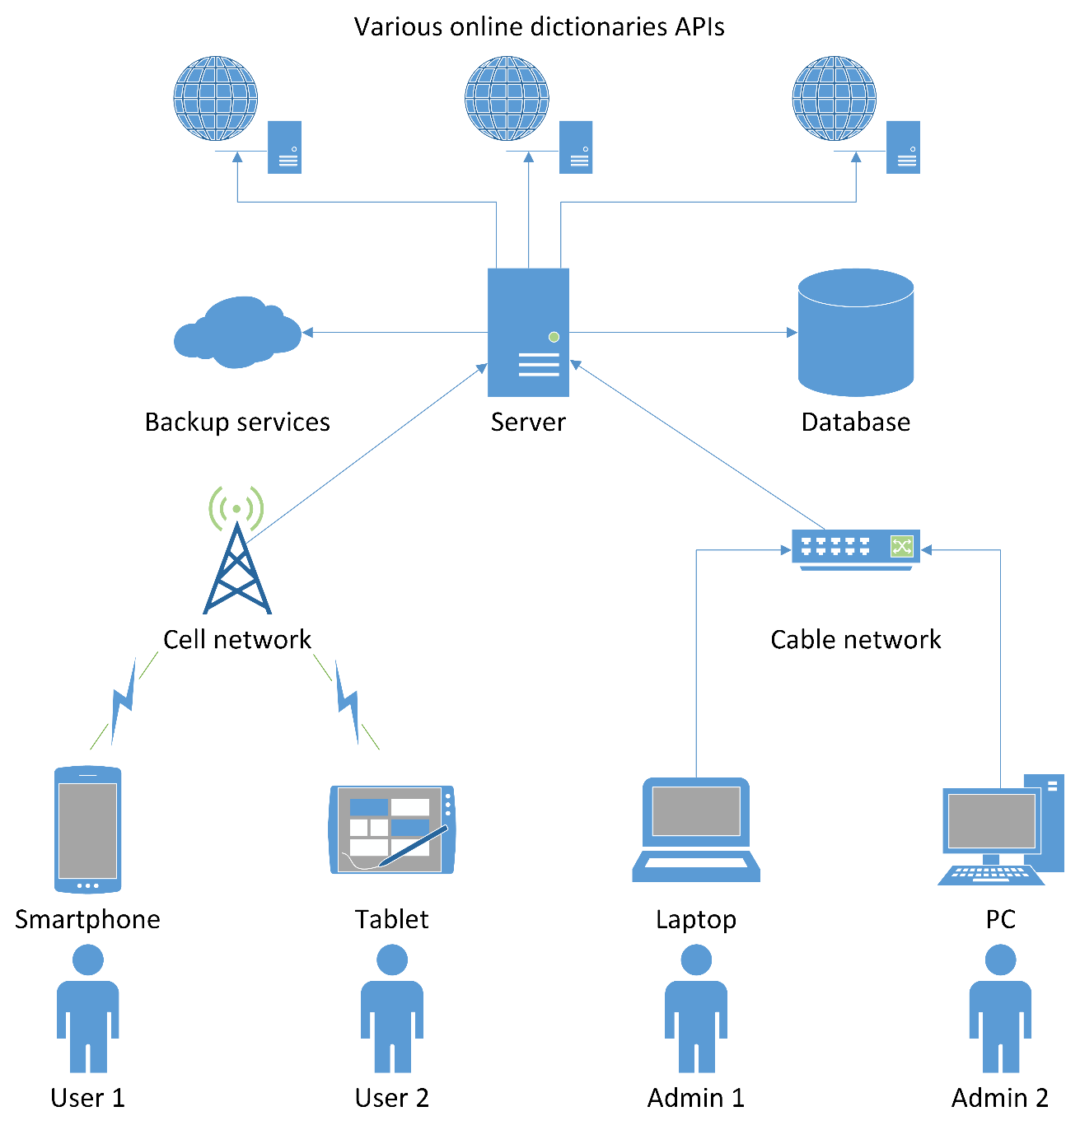
High level design
SaaS
Client-server
RESTful APIs
Third party cloud backup

Slide 7
Architecture
Development plan
Third party APIs used
Retrofit
ReactiveX
Room
Tesseract Tools
Transitions everywhere
Datatables
Challenges
User testing
Notes:
Client-server

Slide 8
Future goals
IOS app/Windows app
More dictionaries & UI languages support
Cloud synchronisation
Integration with browsers and book readers
Premium packages
Blog
Social media pages
SEO and App Store marketing
Update business plan & financial projection
Update terms & conditions
Decide on new features to be implemented
Look for strategic partnership with a coupon firm
Enhance in-app social interaction
Increase brand awareness
Improve customer experience

